Slide 1
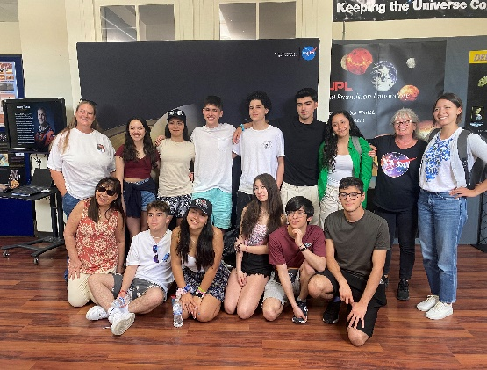
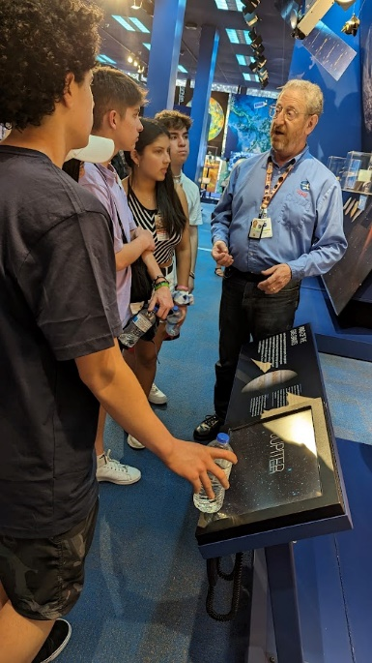
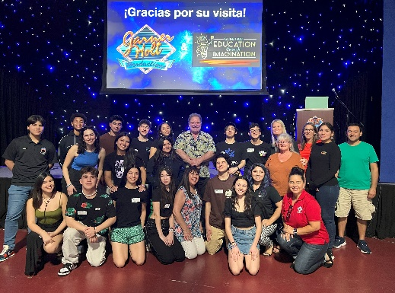
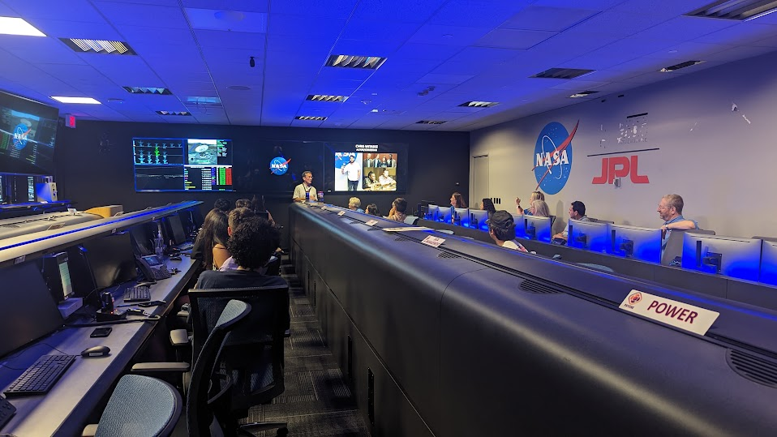
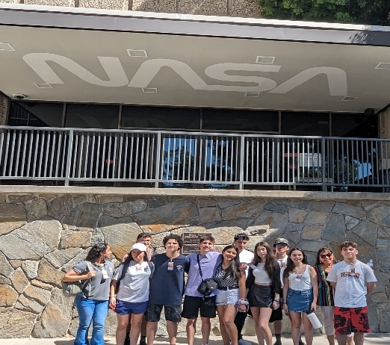
Across the Universe
GAVRT Newsletter
Summer 2023
GAVRT Students from Chile visit California
The Lewis Center welcomed eleven students and two teachers, along with two guests from Chile as part of an exchange program with our San Bernardino school NSLA. The GAVRT students stayed with host families and visited many sights in Southern California, including the NASA Goldstone Visitor Center, JPL, and Garner
Holt Productions. Their busy schedule even included a visit to GAVRT Mission Control where
they ran a mini-Black Hole Patrol session.

