Slide 1
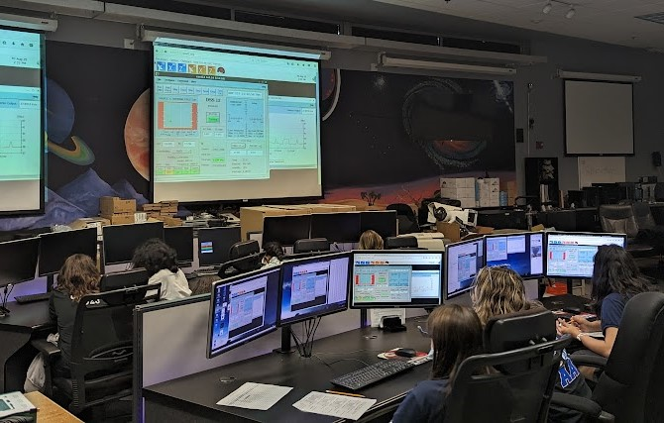
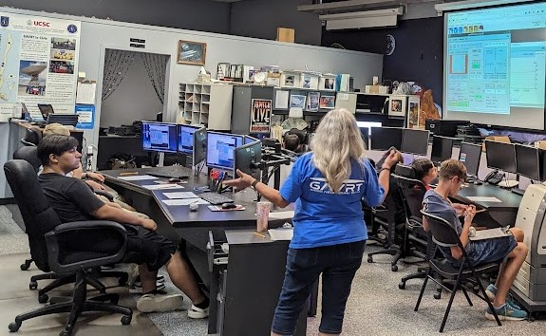
Across the Universe
GAVRT Newsletter
School Year 23-24
GAVRT Black Hole Patrol
The Lewis Center’s school, AAE, 8th grade Space Science class made their first visit for the school year to GAVRT Mission Control. Students were able to take control of, operate, and use the GAVRT antenna to scan radio galaxies and black holes.
Instead of a year long class, Space Science is now a rotation. There will be a new group of students each quarter. This will give more AAE students the opportunity to experience GAVRT and participate in being part of the JPL science collaboration.

