Slide 1
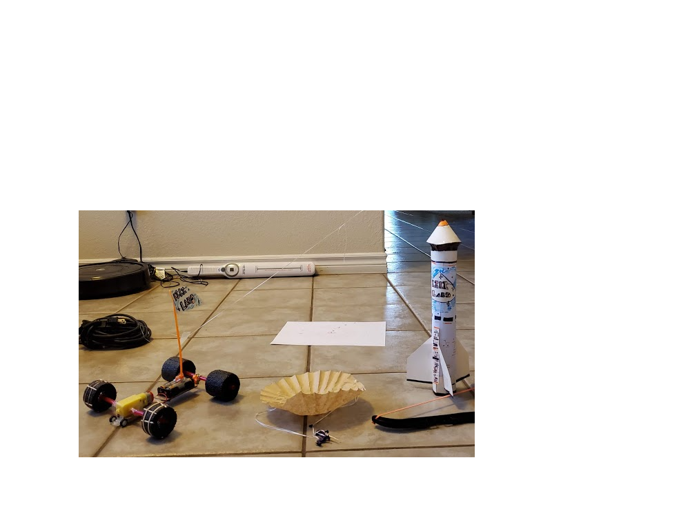
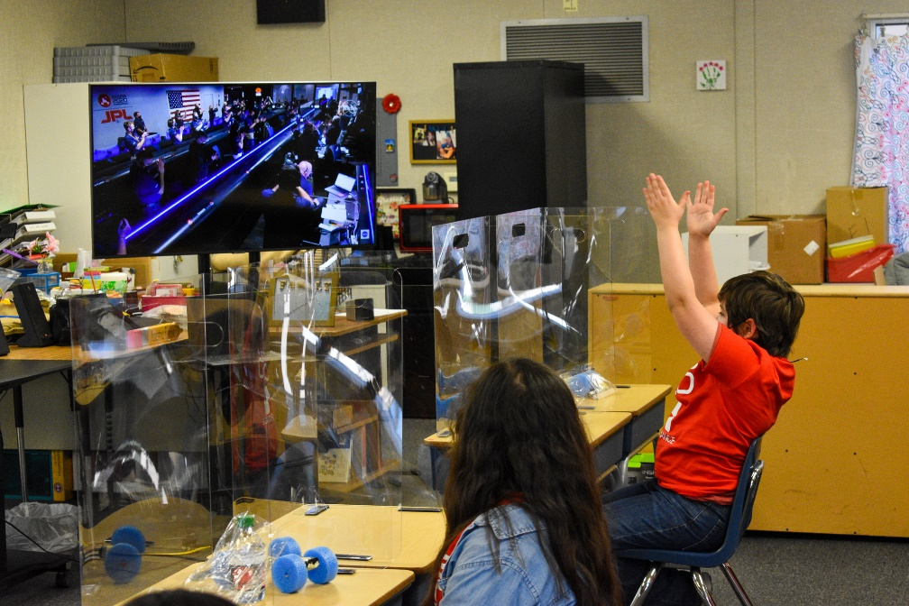
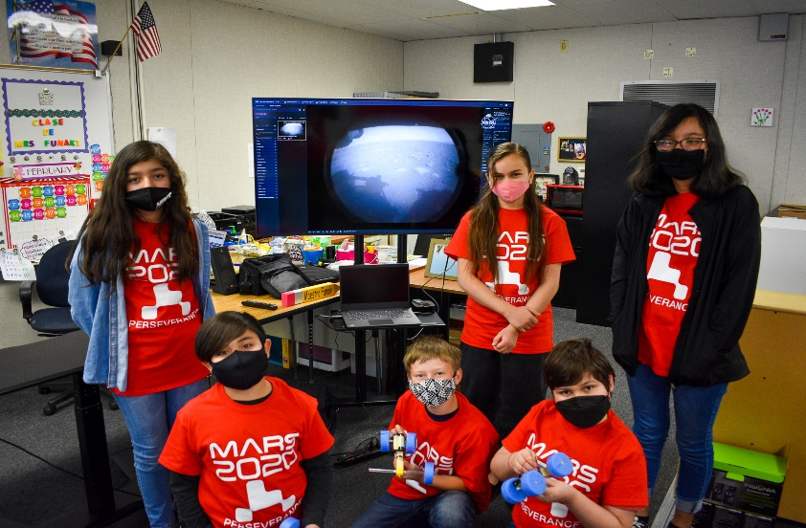
Across the Universe
GAVRT Newsletter
Winter, 2021
GAVRT, together with the Lewis Center’s very own STEM teacher of the month Amy Ritter, had an incredible February! We were privileged to share all about the Perseverance rover and the MARS 2020 mission with 1,307 NSLA & AAE students in just under two week’s time!
After the campaign wrapped up, we had 50 students join us for a premier space camp where they designed their own mission including building a rover, launch and landing vehicles.
Finally, both campuses hosted students on February 18th to watch the landing of the perseverance rover and the subsequent first Martian images sent back!

